Slide 1
High-Impact Lobbying
Joseph Decker, Kevin Kauffman, Maria Markhelyuk, Mark Takagi, and Zachary Taylor

Slide 2
The Problem - Business Value
The Problem: Lobbying takes a lot of effort and money.
Try to better understand politicians’ voting records.
Use machine learning techniques.
Maybe we can target politicians better to maximize our lobbying efforts.
Each team member undertook a different analysis to look at the problem from a different angle.

Slide 3
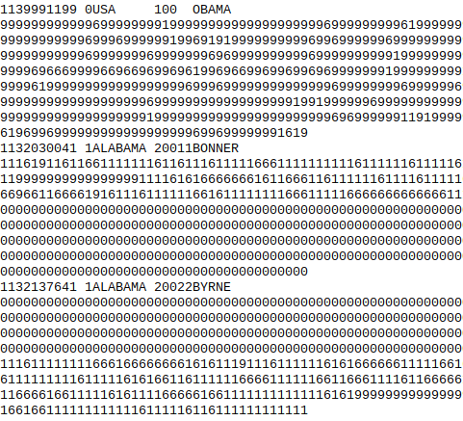
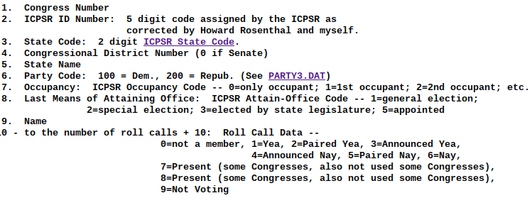
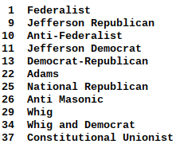
Data Work
Data from voteview.com/dwnl.htm

Slide 4
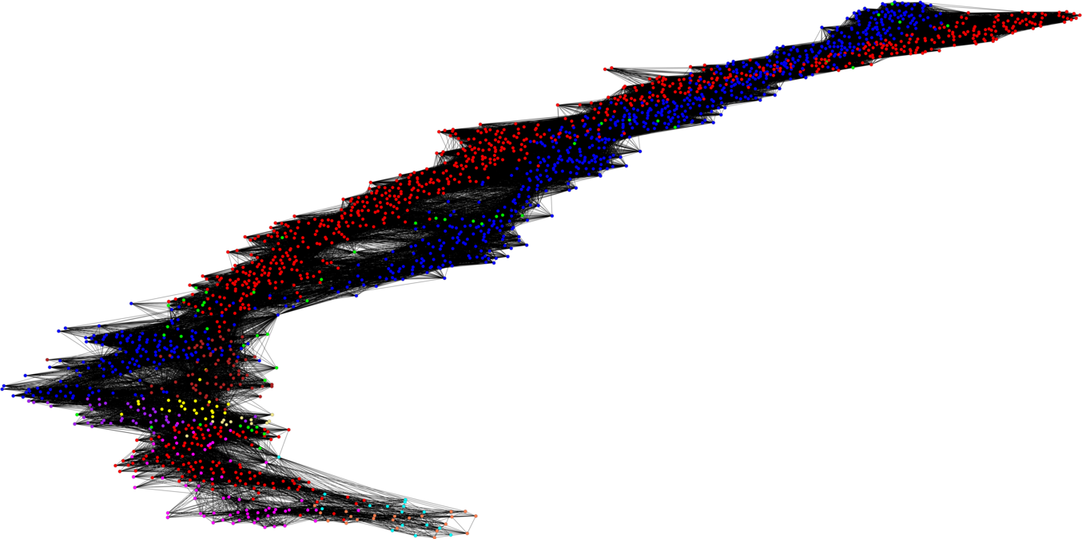
A look at the US Senate
Every Senate since US founding.
Show link if vote together 50% of the time.
Colors represent different parties.
Too many links to make sense of things!

Slide 5
Animated Data Visualization
Change from 50% to 100% threshold for how often votes must by in step.
Makes it easier to see strongly connected clusters.
Partisanship seems to be increasing.

Slide 6
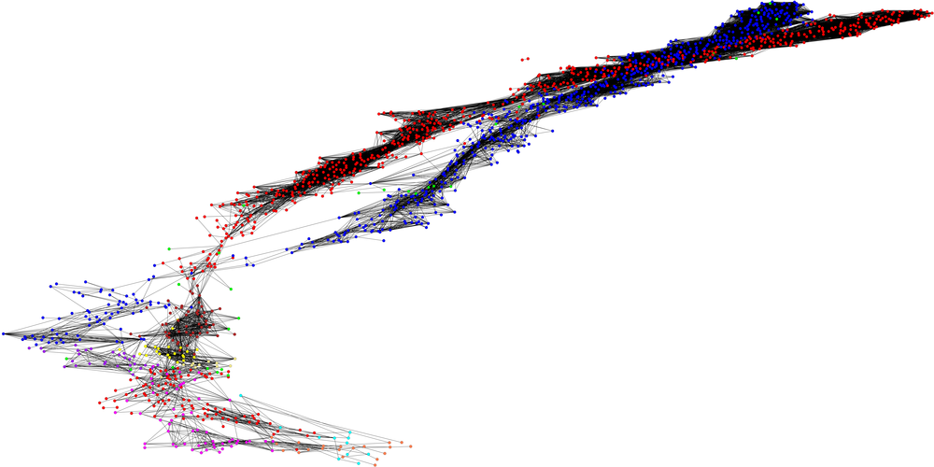
Animated Data Visualization - Vote Together 75%

Slide 7
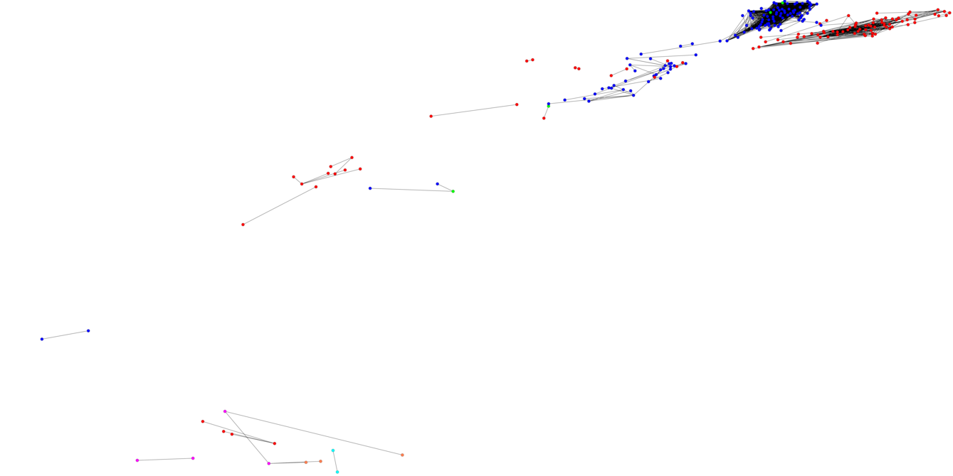
Animated Data Visualization - Vote Together 90%

Slide 8
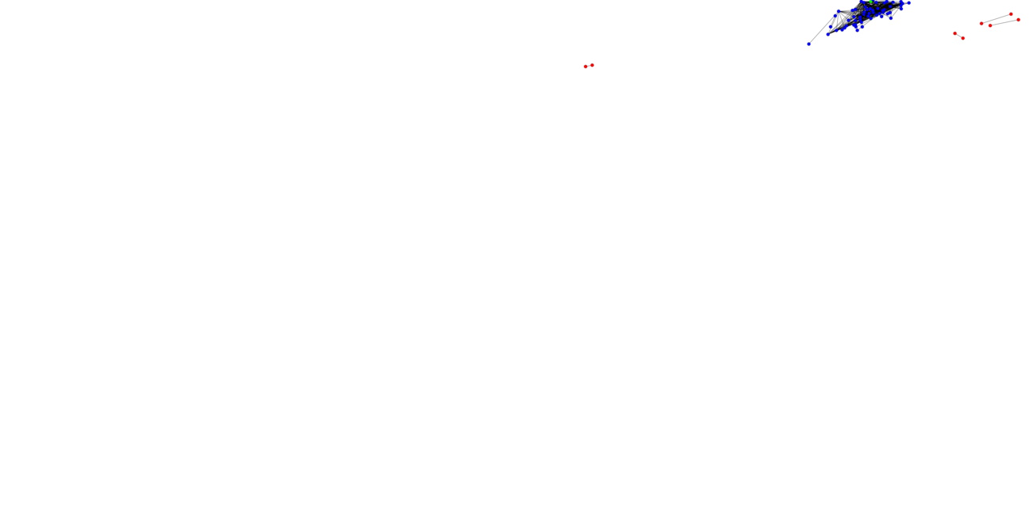
Animated Data Visualization - Vote Together 95%

Slide 9
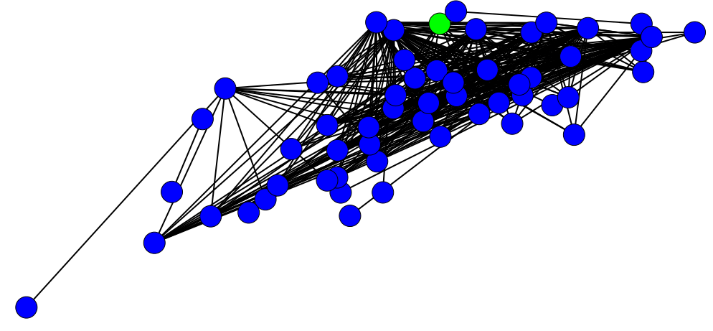
Implied Lobbying Strategy
We can identify groups that nearly always vote in concert.
Target highly connected (influential) individuals in such a group.
Should be attempted for party in power when partisan conflict is high.
Recent democrats and one “independent” that vote together 95% of the time.

Slide 10
Clustering In Spark
Clustering Algorithms, especially on large data-sets can see great speedup when executed in a parallel environment
Take well-known clustering algorithm which is slow on large data-sets and re-implement in spark to take advantage of high-performance clusters (K-medioids)
Generate output of actual clusters/cluster centers

Slide 11
K-Medioids
like K-means, but suitable for a generalized distance metric (select a vertex as the center of a cluster rather than an arbitrary point in space)
Also like K-means, can have poor runtime on large datasets
Only a heuristic solution: depending on randomized selection of initial medioids, may produce different clusterings. Is prone to getting caught in non-optimal local minima
Metric: sum of cosine distance from a medioid to all points in the cluster
Can be used to see which senators have influence at a variety of levels (use small K for broad influence, large K for fine grained influence)

Slide 12
Performance
Step 1: Assign a node to the nearest medioid.
Normally Θ(n*k)
With enough hardware, this can approach O(k * log(n))
Θ(k) for a single vertex to find the medioid it’s closest to
O(k * log(n)) to coalesce the individual nodes into their cluster
Step 2: find the new optimal medioid for each cluster
Normally O(n^2)
Reduced to O(n + k * log(n))
O(n) for each vertex to calculate its metric if it were the new medioid of the cluster
O(k * log(n)) to find the minimum

Slide 13
Experiment
Analyzed senate data from last 30 years
preprocessing the graph outside of spark was the limiting factor!
Ran 100 iterations on a variety of cluster sizes
Small number of senators were at the center of most clusters regardless of Cluster size
McConnell and Mikulski 1-2 across cluster counts (center of Rep and Dem parties!)
Some senators only show up in smaller groups
Cardin #3 when k=4, but does not appear when k=2
Some senators only show up when the groups are large
Blumenthal #4 when K=2, but does not appear when K=4

Slide 14
Clusters in iGraph
Perform cluster analysis individually on each of the previous 13 houses and senates, dating back to 1990
Fast Greedy Modularity Optimization
Determine clusters based on optimal modularity
Good for large datasets, such as house data - other implementations proved to be too slow
Capture cluster size and modularity for each

Slide 15
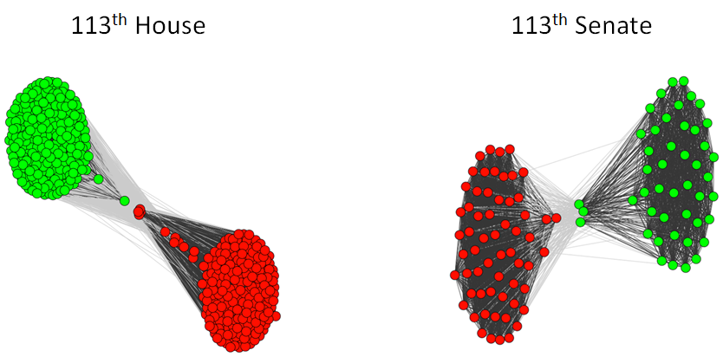
Example Clusters

Slide 16
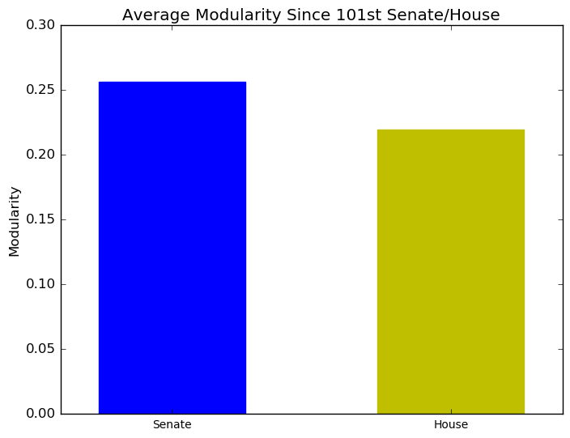
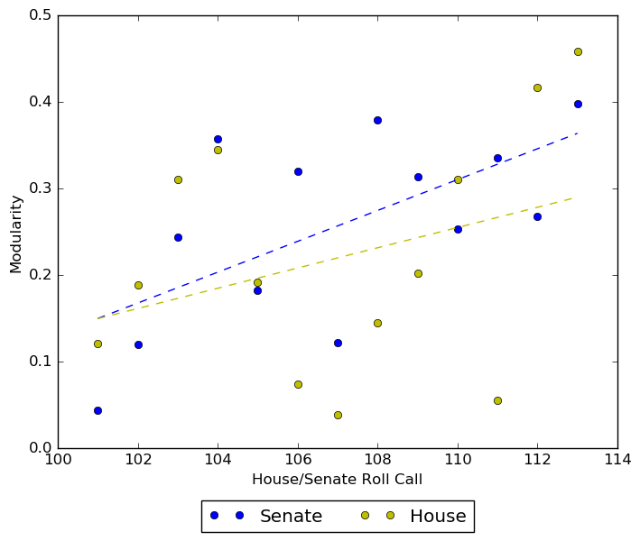
Results
Pushing lobbying efforts towards House of Reps may be more effective than the Senate
House of Reps produced higher number of clusters, and lower modularity
Senate is more tightly coupled, and would be harder to influence an individual
Interesting to note the trend over the past 25 years, showing modularity increasing, likely harder to influence individuals

Slide 17
A Comparison of Community Detection Algorithms
Fast Greedy Algorithm Each node belongs to a separate community initially, and nodes are merged iteratively. A merge is performed only if it leads to the maximum increase in modularity. Merging stops once modularity can’t be improved any further.
Walktrap Algorithm Short random walks of 3 - 5 steps (depending on step parameter) are performed and the results are used to merge separate communities from the bottom up (as in Fast Greedy). Modularity is used to choose where to cut the resulting dendrogram.
Leading Eigenvector Algorithm Initially, all the nodes belong to one community. The graph is iteratively divided into two clusters such that the division results in a significant increase in modularity. A modularity matrix is computed and the corresponding eigenvector is used to determine the split.

Slide 18
A Comparison of Community Detection Algorithms
Data: Roll Call data from the 100th to the 113th U.S. Congress (Same as in previous experiment to provide point of comparison.)
Analysis: Performed Fast Greedy, Walktrap, and Leading Eigenvector community detection on each graph in the dataset using igraph. Compared the quality of the resulting partitions using the modularity scores obtained. (Using modularity since the actual structure of the communities we’d like to target for lobbying purposes is unknown and modularity provides an approximation of goodness.)
Results: Walktrap and Fast Greedy produce nearly the same modularity values, while Leading Vector results in slightly lower modularity scores. Difficult to distinguish quality based on modularity, perhaps coverage or conductance metrics would result in more meaningful comparisons in future analyses. (See next slide for plot.)

Slide 19
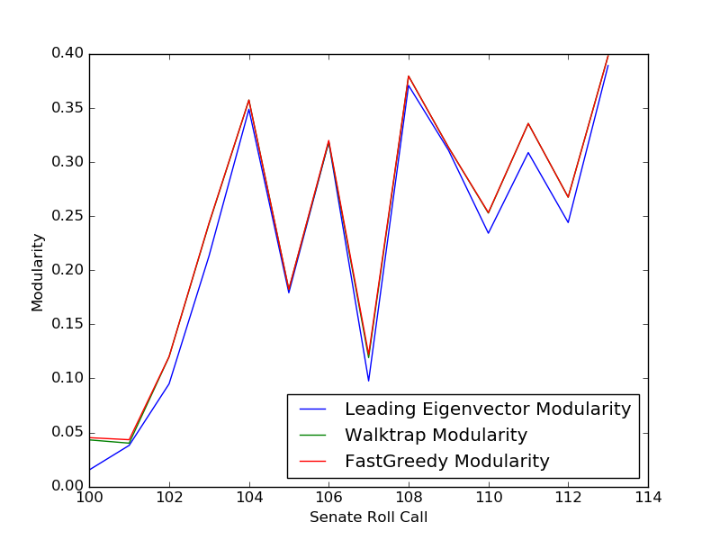
A Comparison of Community Detection Algorithms

Slide 20
Data - Digging Deeper
Can we tell what congress is passing bills on?
What additional features can be found if the corpus of bill text was available?
Notes:
Looking into the data provided we found we could dig deeper.
A session of the house or senate could be mapped to bills in different states. This provides a corpus of text for further feature enhancement.
What other features can be found?
Word2Vec, Hot topics for current congress?

Slide 21
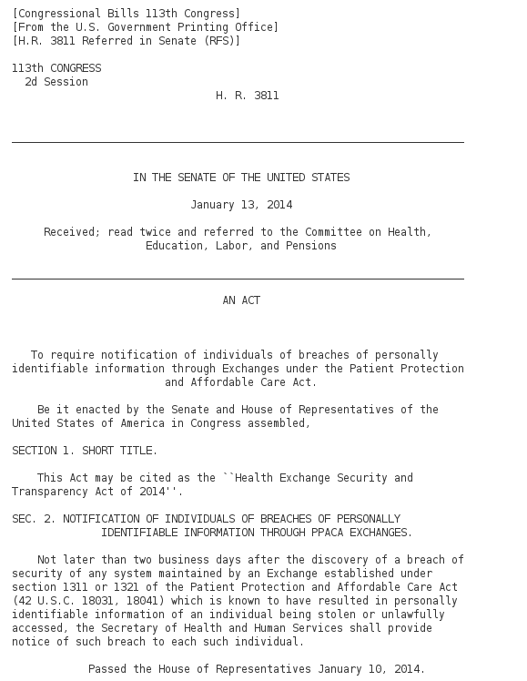
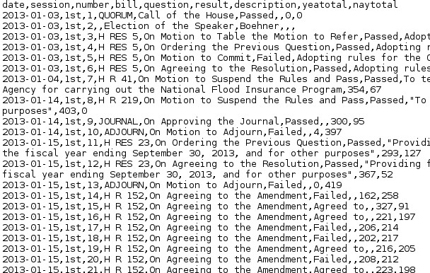
Using a separate BI process - load bill text
Notes:
A first step BI process
By using the names of a bill in the descriptive CSVs, the congress.gov website was scraped using a Clojure Enlive (css selectors) process. Individuals bills were loaded and stored locally and then stored into spark for further investigation.

Slide 22
Data Collection - Difficulties
Web Scraping - Difficulties getting the right content, still only about 40% correctly scraped
Large datasets - Spark handles multiple files easily!
Quality - words can get garbled in parsing i.e. xxiiiair
Incorporating with other graph data - difficult to match back but has possibility of mapping politicians to bill types
Collected approximately 19633023 words of bill text from 763 bills
Notes:
Collection is performed by a web scraper searching congress.gov and scraping bill text.
Individual bills are stored as json files and read in with spark.
Works can have weird quality issues, roman numerals and words running together.
While mapping back to other graph data is possible, it’s difficult but could provide interesting insights.

Slide 23
Bills passed by congress - themes
Word | Count
defence | 6513
fiscal | 6943
funds | 5359
security | 3518
military | 3137
budget | 2328
energy | 2103
housing | 1948
Notes:
Security-defence - budget central themes

Slide 24
Bills failed by congress - themes
Word | Count
land | 2231
area | 1148
water | 1110
food | 904
conservation | 893
wilderness | 879
river | 605
farm | 499
Notes:
Looks like congress isn’t a fan of mother nature.

Slide 25
Word2Vec - Passed- Synonyms - health
synonyms = passed_congress_model\
.findSynonyms('health', 40) for word, cosine_distance in synonyms: print("{}: {}".format(word, cosine_distance))
marketing: 0.895839500546
competitions: 0.849055429027
economically: 0.848936713079
headstones: 0.84857053943
owned: 0.835485145274
correspondence: 0.829716005454
benchmarking: 0.821671952711
outreach: 0.820389391379
socially: 0.819080883186
Notes:
Finding synonyms for health in passed congress bills.
Using word2vec, we can analyze what words are close to each other providing interesting synonyms

Slide 26
Word2Vec - Failed Synonyms - health
priorities: 0.64083128422
systems: 0.63415806923
improve: 0.629074653369
communication: 0.62721723196
colleges: 0.622499133964
resource: 0.615561390819
products: 0.614292804891
upgrades: 0.605861872278
pest: 0.599340724698
Notes:
Finding synonyms for health in failed congress bills.
Interesting what words get lumped in with failed bills mentioning health i.e. improve.

Slide 27
References
DW-Nominate - http://voteview.com/pdf/nomboot.pdf
Fast Greedy Modular Optimization - http://arxiv.org/abs/cond-mat/0408187
Community Detection Algorithms: a comparative evaluation on artificial and real-world networks - http://www.robots.ox.ac.uk/~yannis/psorakis-report1.pdf
An Evalutation of Community Detection Algorithms on Large-Scale Email Traffic - http://www.syssec-project.eu/m/page-media/3/moradi-sea12.pdf
A Comparison of Community Detection Algorithms on Artificial Networks - https://hal.archives-ouvertes.fr/hal-00633640/document

